Slide 1
Ansible – Configuration Management System

Slide 2
What is Ansible?.
Ansible is a lightweight, open source IT automation tool
Has an Agentless architecture
Nodes do not require to install and run background daemons
Reduces the pressure on the network

Slide 3
Why Ansible?.
Provisioning
Configuration management
Continuous delivery
Application deployment
Security compliance
Can be done through scripts(Time consuming,Coding skills,Maintenance)
Powerful
Agentless
Simple

Slide 4
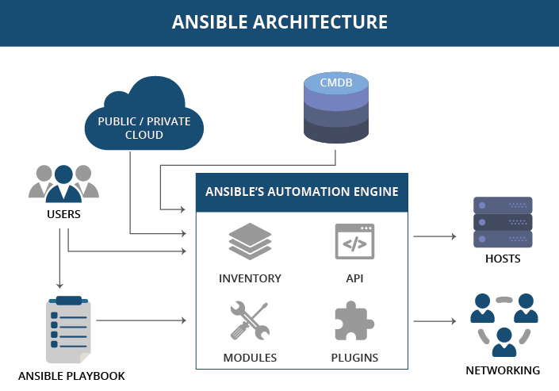
Ansible Architecture

Slide 5
Ansible Foundation
Provisioning
Configuration management
Continuous delivery
Application deployment
Security compliance
Can be done through scripts(Time consuming,Coding skills,Maintenance)
Powerful
Agentless
Simple

Slide 6
Why Ansible?.
Yaml
Ansible Inventory
Ansible Playbook
Ansible Modules
Ansible Variables
Conditionals
Loops
Ansible Role

Slide 7
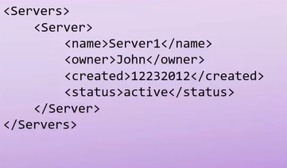
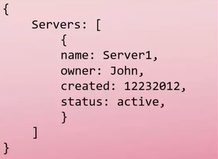
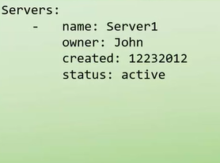
Yaml
Yaml is a text based format
Configuration file in Ansible written in Yaml
Xml Json Yaml

Slide 8
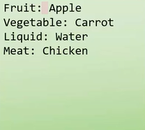
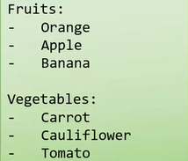
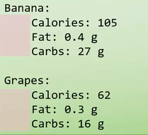
Yaml
Key value pair Array/List Dictionary/Map

Slide 9
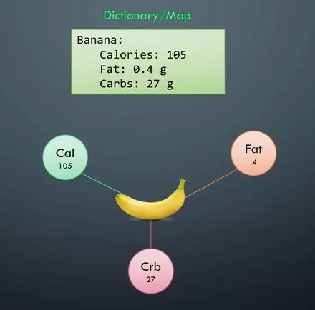
Yaml - Spaces

Slide 10
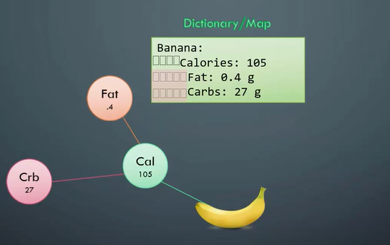
Yaml - Spaces
Equal no. of spaces

Slide 11
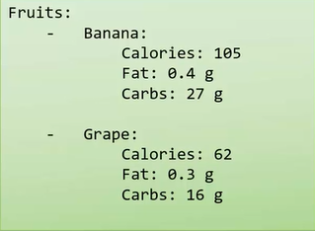
Yaml - Advanced
Key Value / Dictionary / Lists

Slide 12
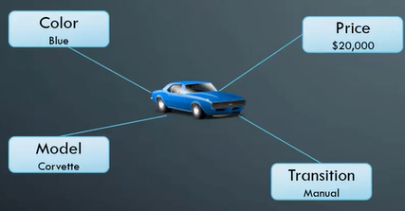

Dictionary vs List vs List of Dictionaries
Dictionary

Slide 13
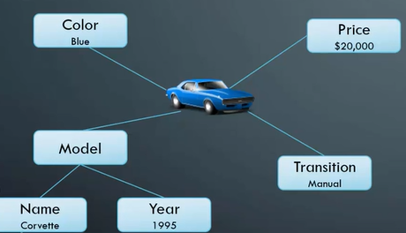

Dictionary vs List vs List of Dictionaries
Dictionary In Dictionary

Slide 14


Dictionary vs List vs List of Dictionaries
List Of String

Slide 15
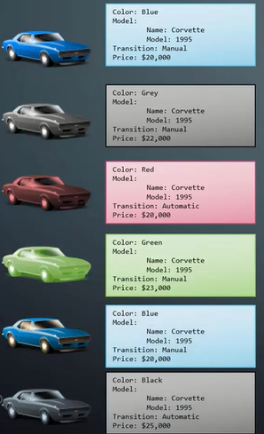
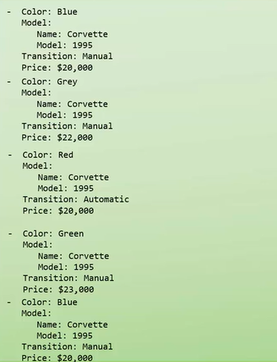
Dictionary vs List vs List of Dictionaries
List Of Dictionary

Slide 16
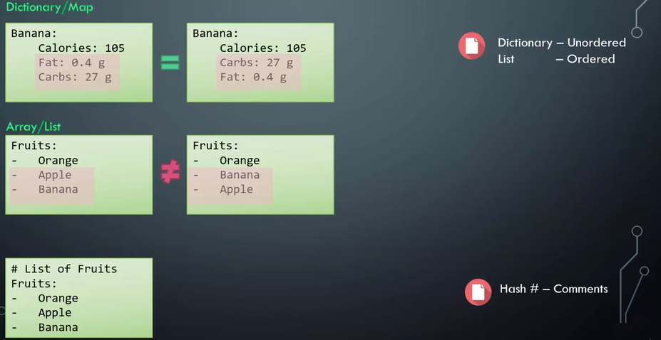
Yaml – Notes

Slide 17
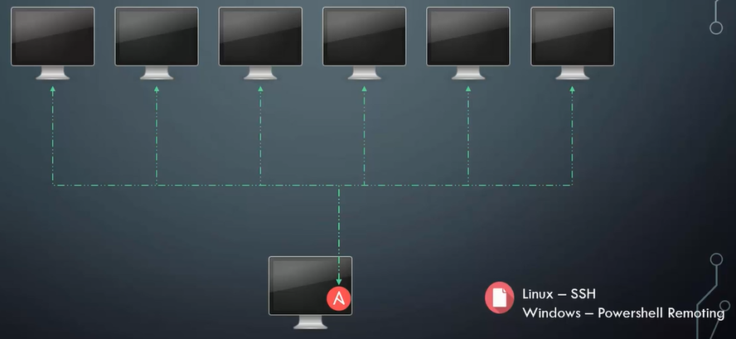
Inventory- Server Info File

Slide 18
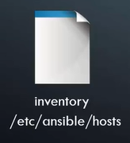

Inventory - Structure

Slide 19
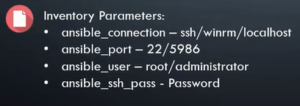
More on Inventory
web ansible_host=server1.company.com
db ansible_host=server2.company.com
mail ansible_host=server3.company.com
web2 ansible_host=server4.company.com

Slide 20
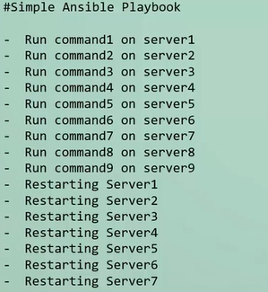
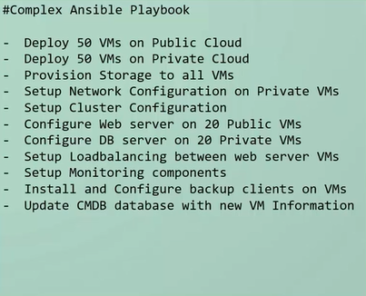
Ansible Playbooks
We define what we want Ansible to do
Set of instruction we provide to Ansible to do its magic
Can be simple of can be complex as per requirement

Slide 21
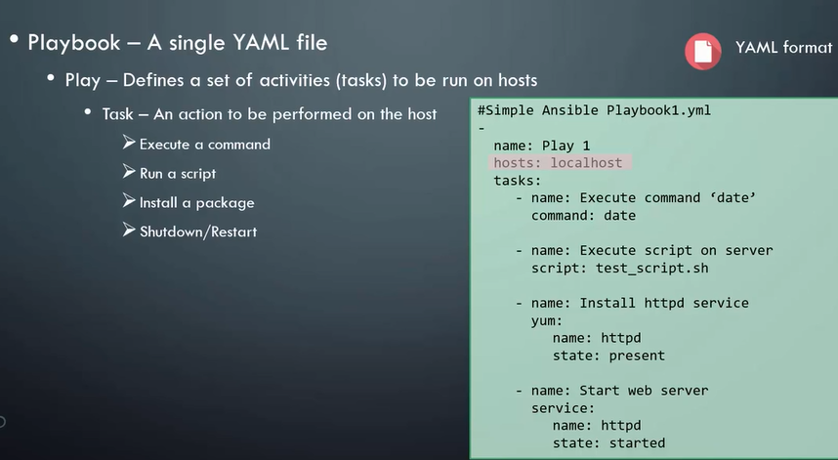

Slide 22
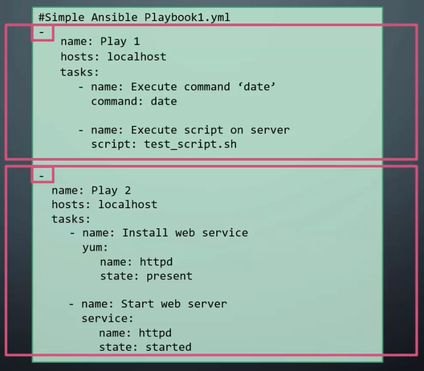
Ansible Playbooks

Slide 23
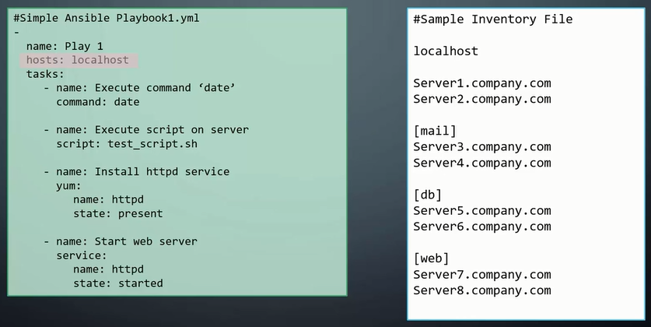
Ansible Playbooks - Host

Slide 24
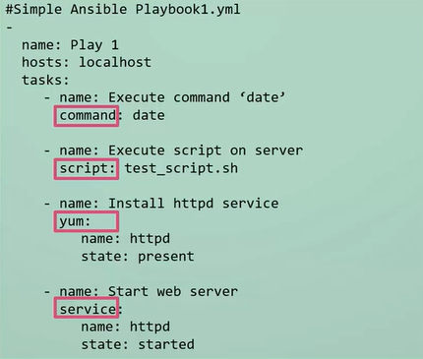
Ansible Playbooks - Module
Different action run by a task is called Module

Slide 25
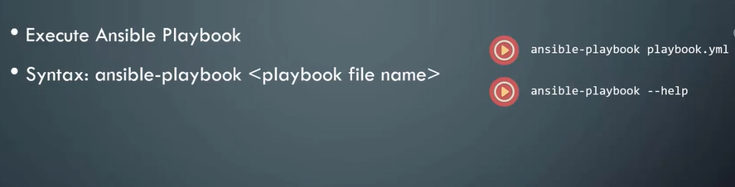
Ansible Playbooks - Run

Slide 26

Modules

Slide 27
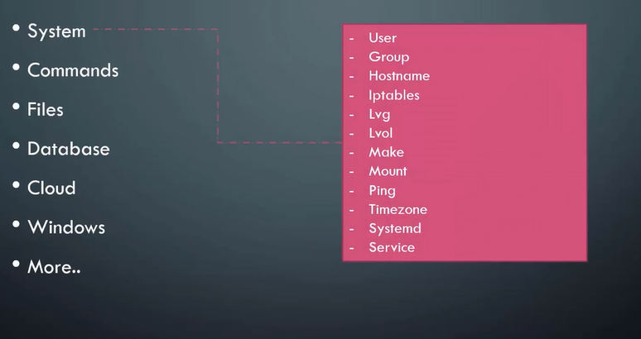
Modules

Slide 28
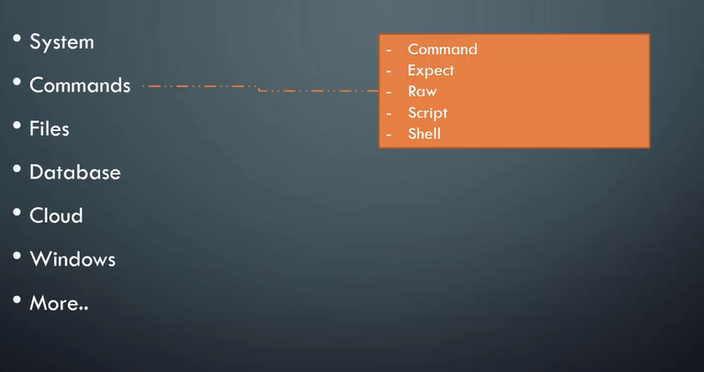
Modules

Slide 29
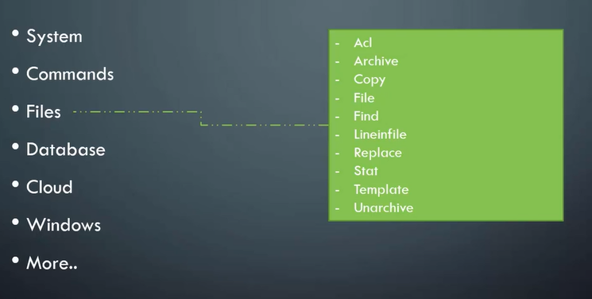
Modules

Slide 30
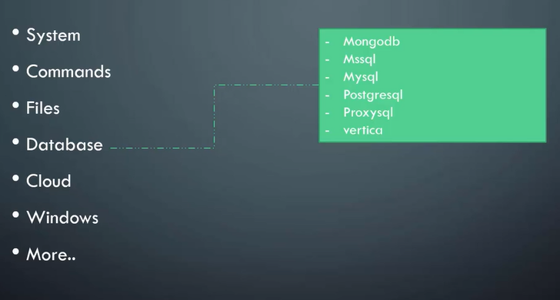
Modules

Slide 31
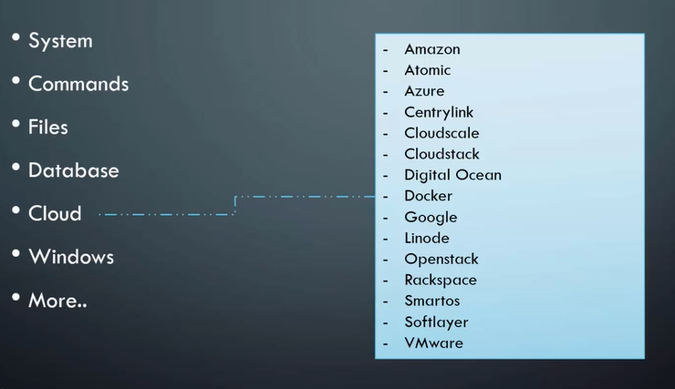
Modules

Slide 32
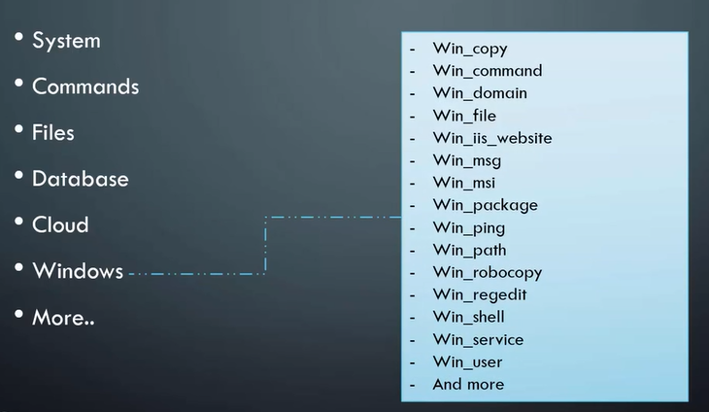
Modules

Slide 33
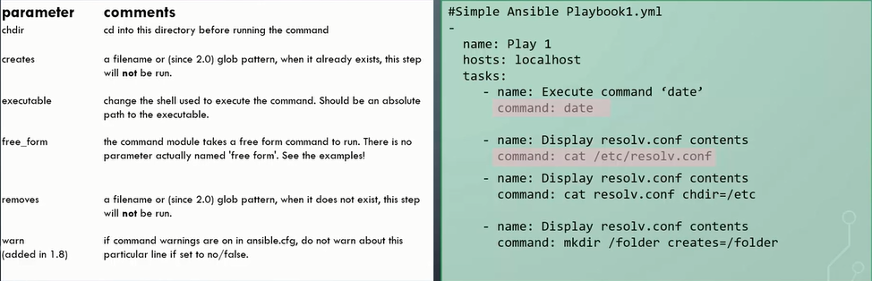
Modules - Command

Slide 34
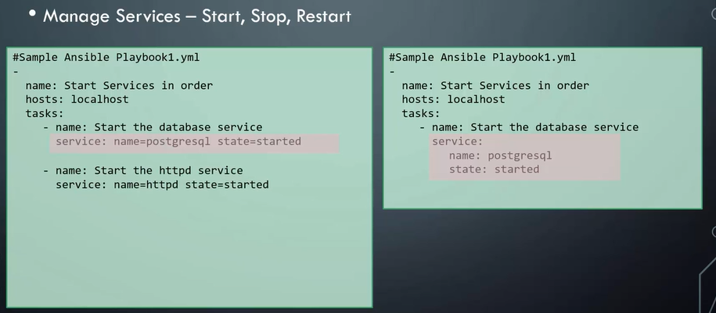
Modules - Service

Slide 35
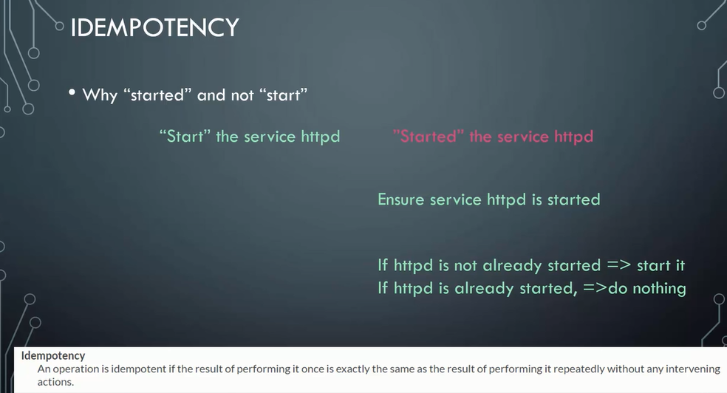

Slide 36
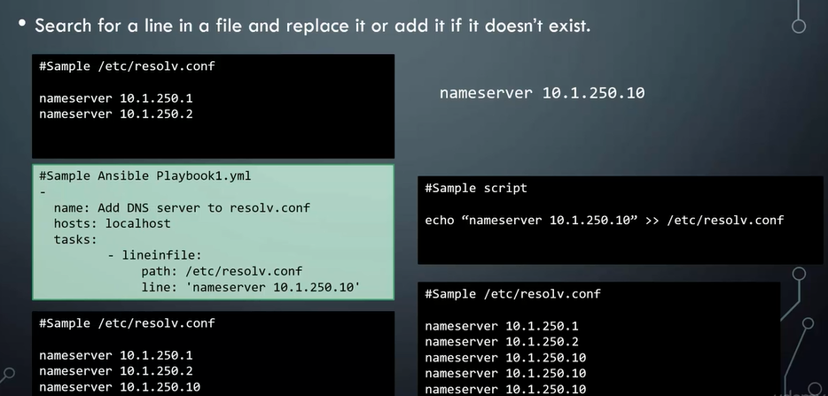
Modules - LineInFile

Slide 37
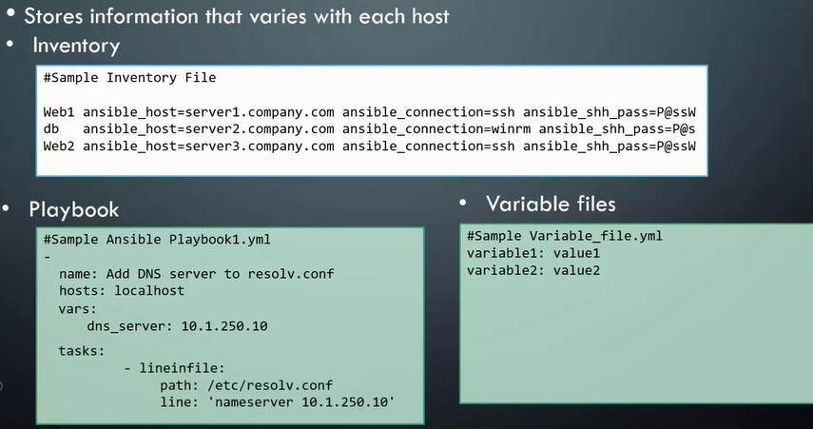
Variables

Slide 38
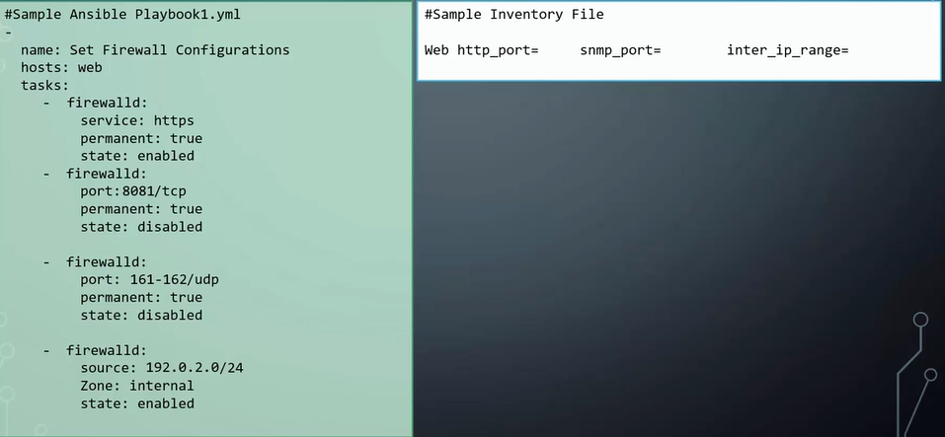
Variables – In Use

Slide 39
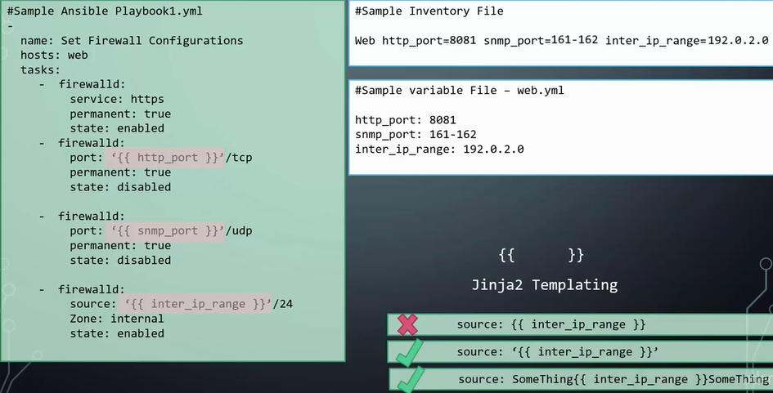

Slide 40
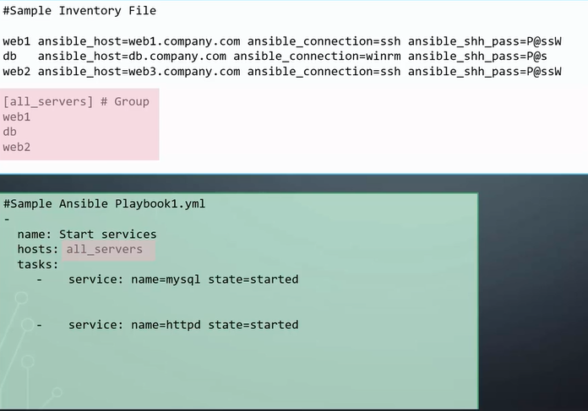
Conditional

Slide 41
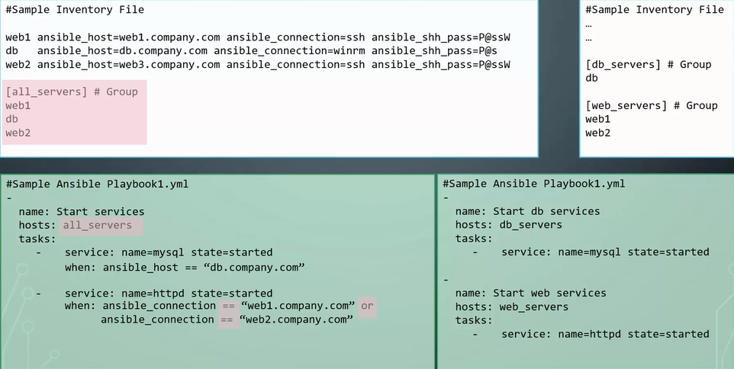
Conditional

Slide 42
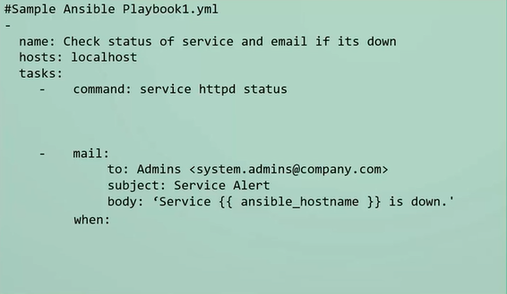
Register And When

Slide 43
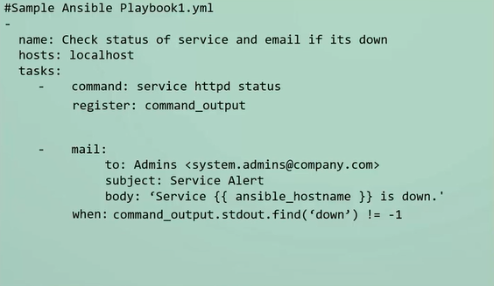
Register And When

Slide 44
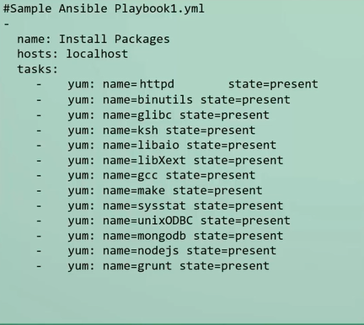
Loops

Slide 45
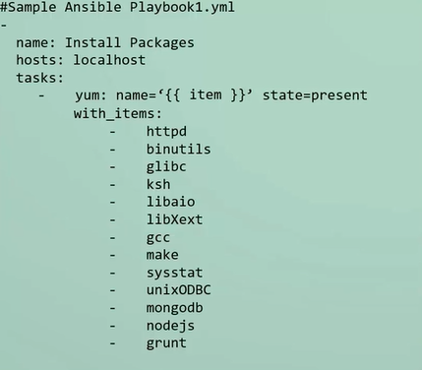
Loops

Slide 46
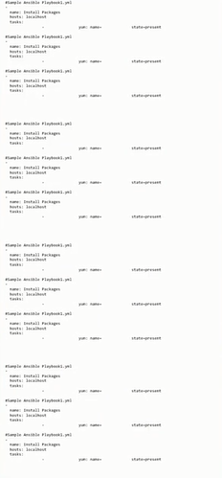
Ansible - Roles

Slide 47
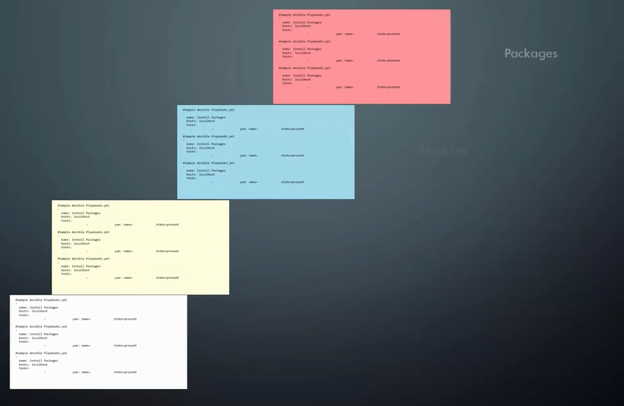

Slide 48
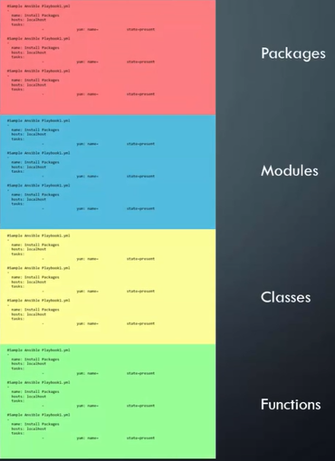

Slide 49
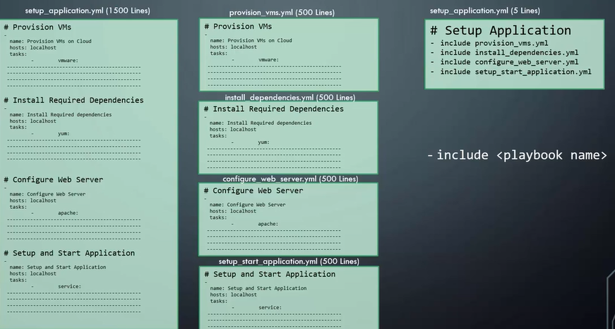
Include

Slide 50
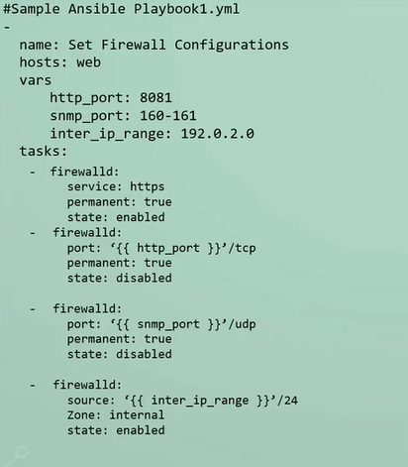
Include Task And Vars

Slide 51
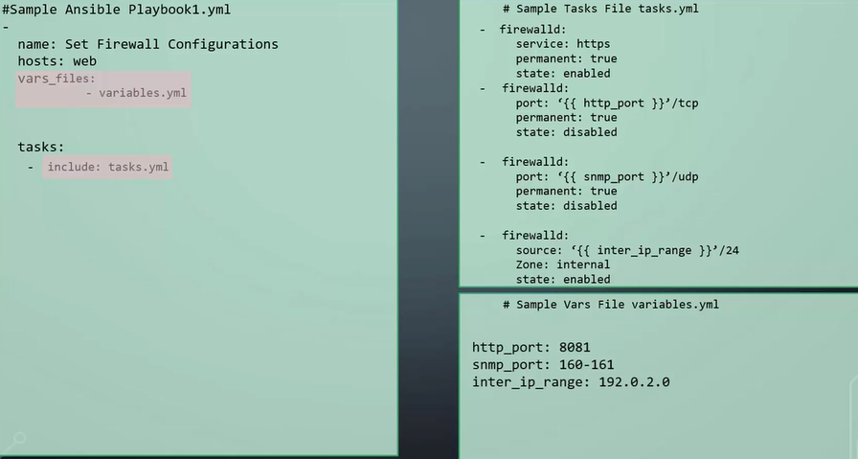
Include Task And Vars

Slide 52

Roles – Organizing the files

Slide 53

Roles – Organizing the files

Slide 54
Roles – Organizing the files

Slide 55

Roles – Organizing the files

Slide 56

Temples - filters

Slide 57

Jinja2 – filters List and Set

Slide 58

Jinja2 – filters For File

Slide 59
Ansible Vault
A feature of ansible that allows us to keep sensitive data
Such as passwords or keys in encrypted files, rather than as plaintext
Ansible Vault can encrypt any structured data file used by Ansible
Reduces the pressure on the network

Slide 60

Ansible Vault

Slide 61

Ansible Vault

Slide 62

Dynamic Inventory
Inventory information that Ansible retrieves programmatically when ansible playbook is run as oppose to us defining in static text file

Slide 63

Dynamic Inventory

Slide 64

Dynamic Inventory

Slide 65

Custom Modules

Slide 66


